Slide 1


Kickstarter Executive Presentation
Presenter: Jake Ehlers
Date: 7/25/20

Slide 2
Looking at Kickstarter products, there is an overall success rate of 40%. In order to increase chances of project success, backing projects in more successful categories as well as increasing the number of backers with better incentives would be beneficial.
Projects in the main categories of Dance, Theater, and Comics are around 20% more likely to be successful than the overall, while projects in Technology, Journalism, and Crafts are around 20% less likely to be successful.
Dance and Theater tend to raise more on average, with pledge amounts of around $0.60 per $1.00 goal amounts, while Technology and Journalism receive an average of $0.02 per $1.00 goal amount.
Having a longer project duration is less likely to be successful, projects should look to have a shorter funding duration and avoid extending their deadline to potentially increase chances of success.

Slide 3
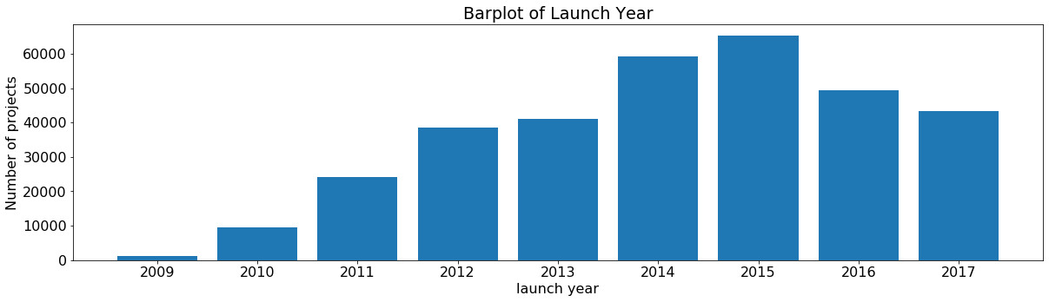
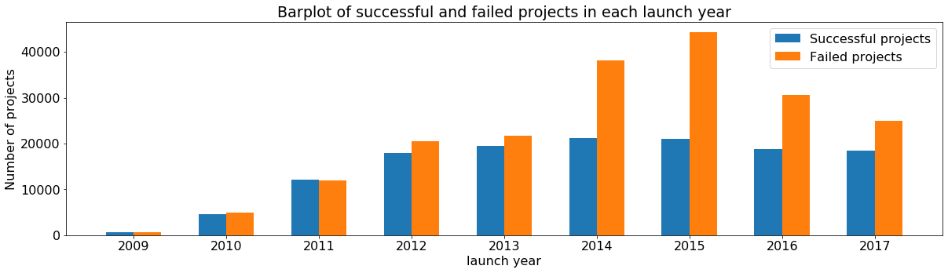
Number of successful projects throughout the years hasn’t varied much, even with the increased competition, however with the number of projects decreasing since 2015 the overall success rate is on the rise from 32% to 42%.

Slide 4
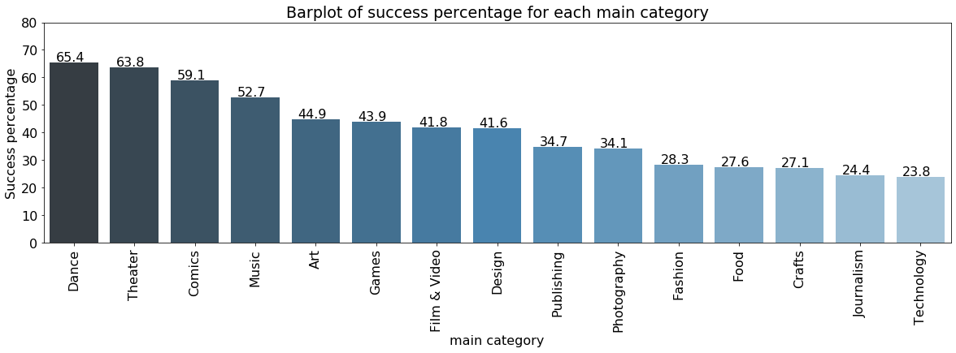
With an overall project success rate of 40.4%, we can see that Dance and Theater top the list in success percentage while Technology and Journalism make up the worst success percentages.

Slide 5
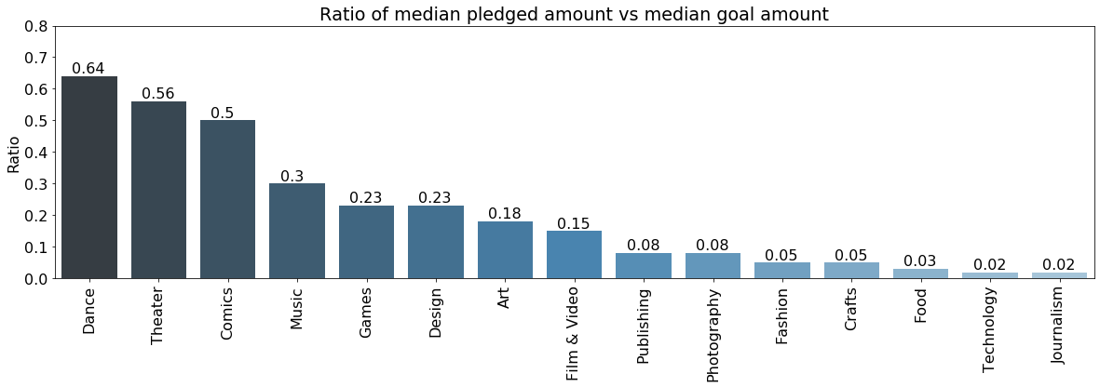
Dance, Theater, and Comic tend to raise more money than the other main categories, with pledge amounts of above $0.50 per $1.00 of goal amounts. This relates to the success percentages of each main category, as we see Journalism and Technology at the bottom.

Slide 6
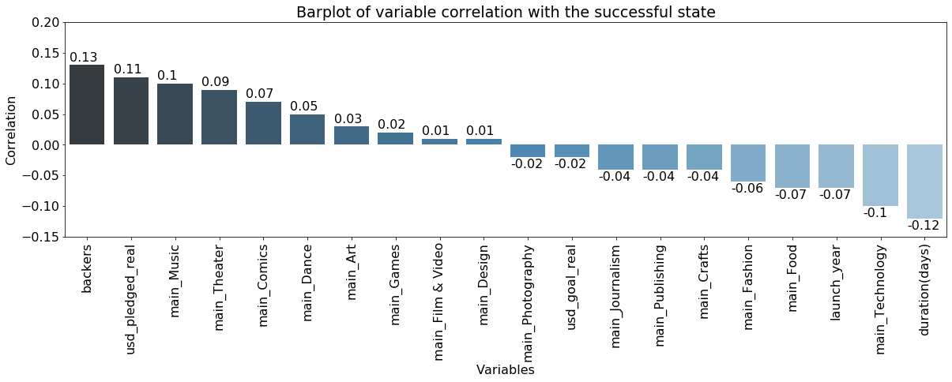
Project duration has a negative relationship with success, so project should look to have shorter durations to have better chance at success.
The categories of Music, Theater, Comics, and Dance have a positive relationship with success, which mirrors the success percentages.
Technology, Food, and Fashion have a negative relationship with success, so they are less likely to be successful.

Slide 7
Projects in the main categories of Dance, Theater, and Comics are more likely to be successful and have more pledge amounts on average. Having a shorter funding duration may lead to better chances for success.
Key Insights
Some main categories on the rise of pledged amounts over the years, including Comics, Games, Design, Art, and Publishing.
Having a shorter funding duration is beneficial to increasing chances for success.
Obtaining information on the whole funding life of a project would be useful to analyze for trends in the funding process.

